Slide 1
APZ Invoice Submission Tips
9/27/2023

Slide 2
Overview
New Requirements for ESG + TANF Submissions (Starting September)
HHA review process: What we check before we "approve" invoices for submission to DCF and why (Slide 6-7)
Best Practices for Common Issues
HMIS Documentation for Monthly Service Reports (Slides 9-11)
Reconciling Rollup Amounts with Receipts (Slides 12-13)
Payroll Documentation (Slides 14-17)
Invoice vs Expenditure Reports (Slides 18-20)
Matching Funds (Slides 21-22)

Slide 3
New ESG + TANF Requirements for September
z

Slide 4
New Rollup Forms for ESG + TANF
Must itemize (and provide documentation for) administrative expenses.
The admin percentage is used as a cap rather than to calculate costs
The new rollup allows you to add additional lines to each section
You do not need to do "additional expenses" separately if you go beyond 9 itemized expenses
But, adding lines can mess with the formula, so double check totals on rollup before submitting.

Slide 5
What does HHA check when reviewing invoices?
z

Slide 6
HHA Review Process:
HHA uses your approved invoices to build a combined COC invoice that we send to DCF with transactions and deliverables organized by program (shelter, outreach, etc) rather than by organization.
Goal is to pass the DCF review process so that payments are not delayed or reduced

Slide 7
HHA Review Checklist
Check Deliverables
Does MSR match HMIS report for a) Total clients served this month; b) new clients served?
Does Expenditure/Invoice Deliverables match total clients served reported on MSR
Check Expenditures
Review Rollup to ensure all expenses are "allowable" for category of grant
Compare Rollup Report with Documentation
Every transaction has required documentation
Amounts on rollup match amounts in documentation
Total is correct
Make sure totals in Rollup match totals in expenditure report
Check accuracy of YTD calculations.
Compare Match Amounts on Expenditure Report to Match Documentation (ESG-CV exempt)
Check Invoice (ESG-CV exempt) to ensure correct amounts are invoiced
ESG: 1/12th of the award each month regardless of expenditures.
TANF: 1/11th of the award each month regardless of expenditures.

Slide 8
Best Practices for Common Issues
z

Slide 9
Matching MSR to HMIS Reports
Issue: HMIS report does not match MSR
Solution:
HHA only needs one Client Served Report (CSR) from HMIS for each project (outreach, shelter, etc) covering the invoiced month.
Set served date range to the service month (e.g. for September 9/1/2023-9/30203)
Set served before date range(old client count) to cover the start of the grant cycle to the day immediately prior to the service month (e.g. for ESG September 7/1/2023-8/31/2023)
We do not need a separate CSR documenting YTD total (that is checked by adding verified new clients to previous months YTD total)

Slide 10
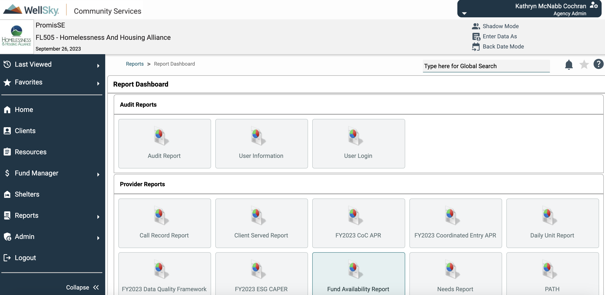
Matching MSR to HMIS Reports

Slide 11
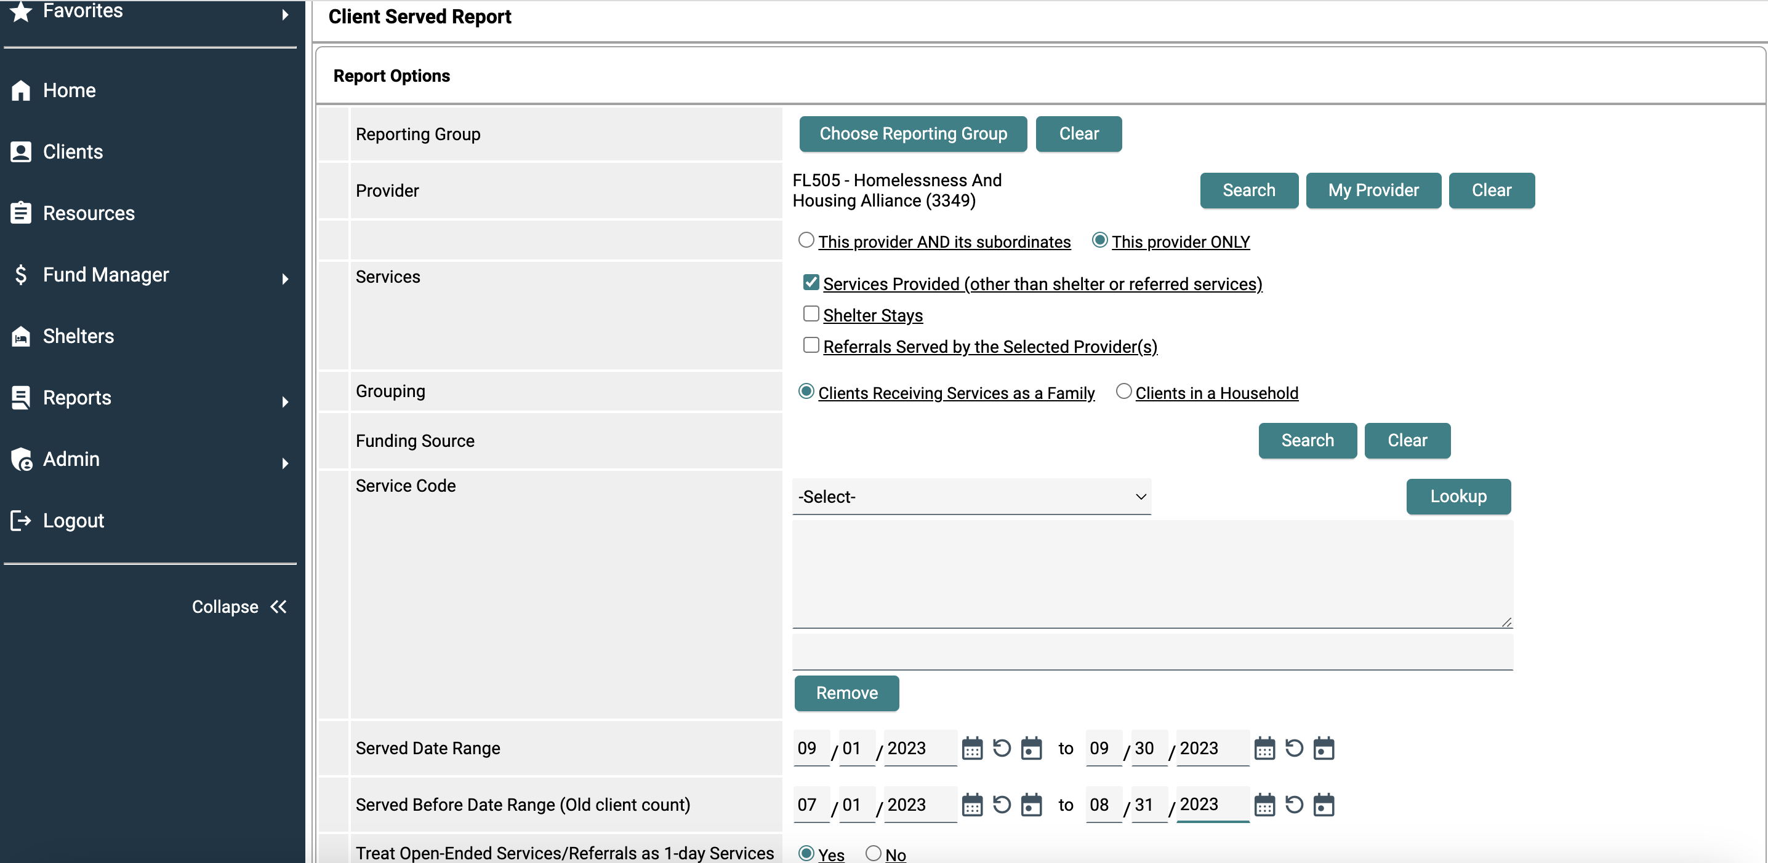
Matching MSR to HMIS Reports

Slide 12
Matching Roll up to Documentation
Issue: Transaction Amount on Rollup Doesn't Match Receipt
Solution:
Make sure there is a receipt for every transaction
Make sure the totals match.
If you are only charging part of the transaction's total to ESG, make that visible and obvious on the receipt (see example on next page).

Slide 13
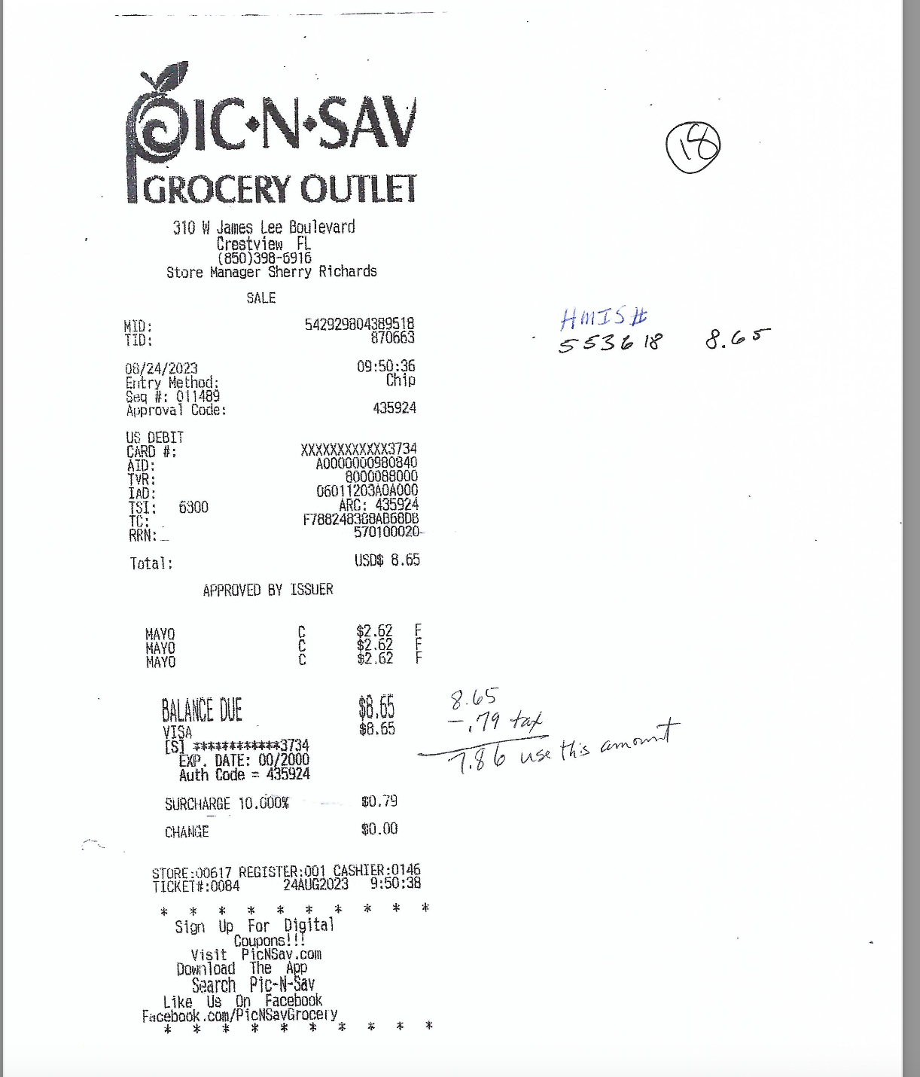
Matching Rollup to Documentation

Slide 14
Payroll Documentation
Issue: Insufficient documentation for payroll
Solution:
Payroll documentation includes 3 components
Payroll worksheet showing what percentage of salary is covered by grant
Payroll receipt confirming salary payment
Timesheet confirming hours spent on activities covered by grant

Slide 15
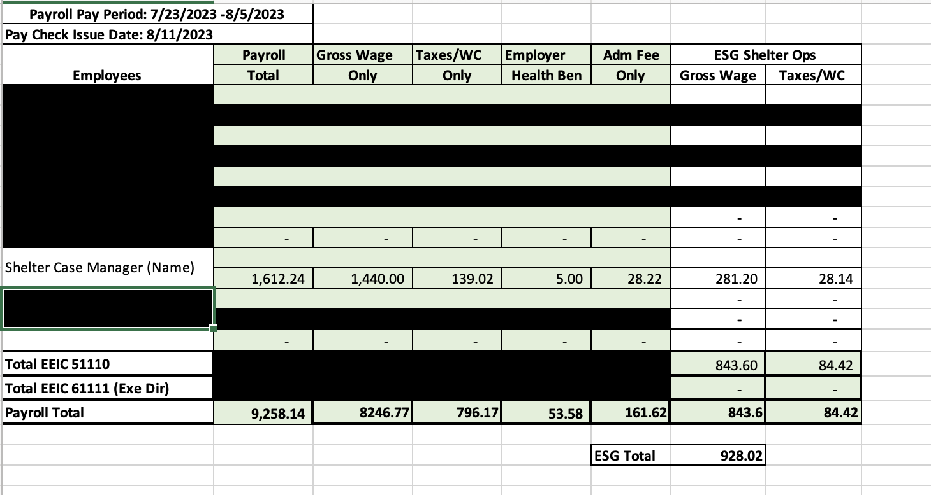
Payroll Documentation
Percentage of Salary allocated to ESG for each employee
The total for her salary can be verified on the job cost report.
The ESG Total matches the amount listed on the rollup

Slide 16
Payroll Documentation
Employee Total and Payroll Total Match Worksheet

Slide 17
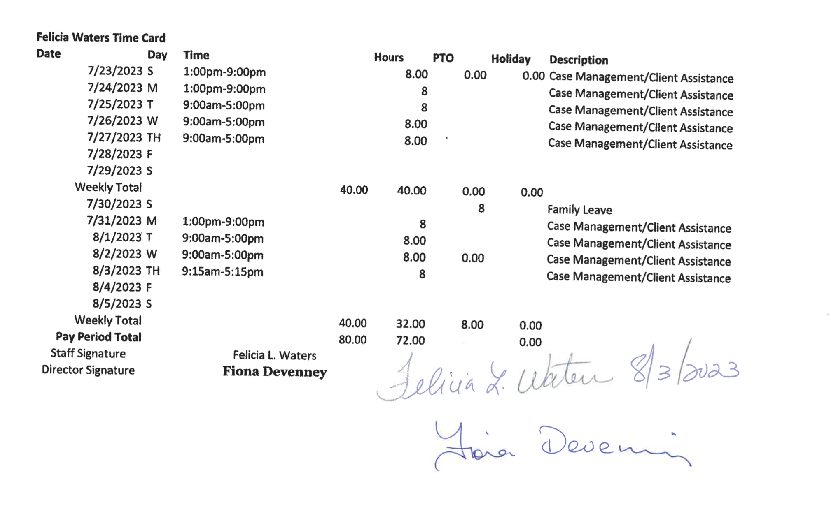
Payroll Documentation
Description references activities that are included in "allowable expenses"
Time card is signed or otherwise verified by both staff and manager

Slide 18
Invoices vs Expenditure Reports
Note: Only applies to pro-rated awards that pay a set amount monthly.
ESG + TANF
NOT ESG-CV, HUD RRH, or CDBG
**If you receive set payment each month regardless of expenditures you should be submitting both expenditure report and invoice***
Issue: Submitting Expenditure Report As Invoice
Solution:
These are two different documents
Invoice tracks how much you are paid each month (total award /12)
Expenditures track how much you have actually spent to ensure organization is on track to expend funds by end of the year.

Slide 19
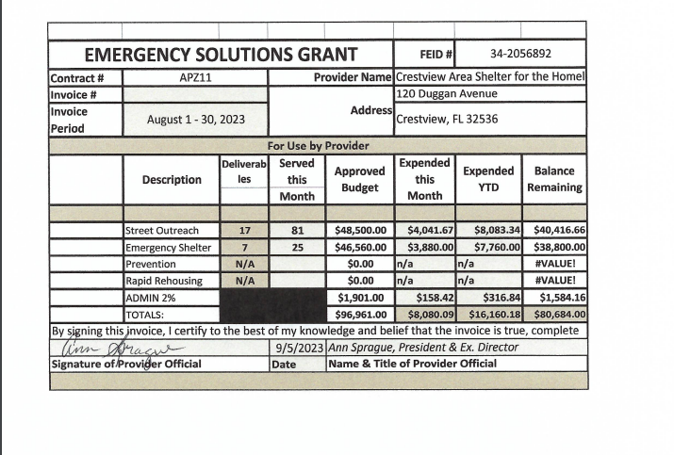
Invoices
For the Invoice—the amount expended is 1/12th the total award. It is the same every month.
Invoice must be signed so should be submitted as a pdf.

Slide 20
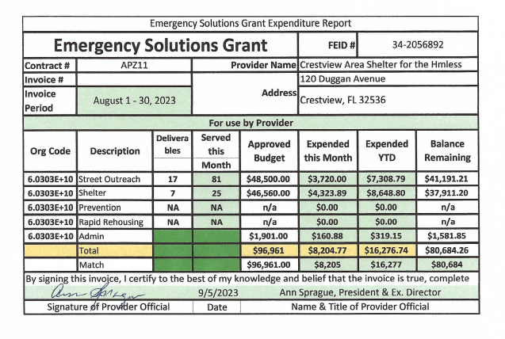
Expenditure Reports
For the expenditure report: Expended amounts should equal the amounts listed in the rollup of itemized transactions
Matching funds should be included on the expenditure report. Their total should match the total in your documentation.
Expenditure Reports must also be signed and submitted as a pdf

Slide 21
Matching Funds
Issue: No matching funds are listed or the amount does not equal the amount provided in the documentation
Solution:
Always include matching amounts on the expenditure report.
Note ESG-CV does not require matching funds
Along with match documentation include a match report that provides breakdown of what funds are being used for the match requirement

Slide 22
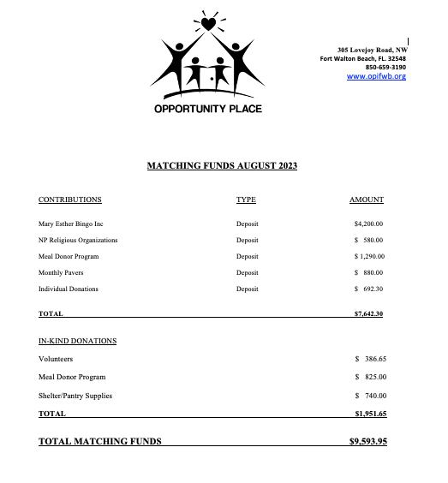
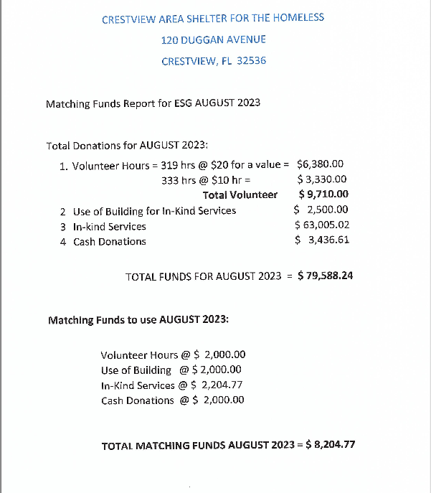
Matching Funds
OPI provided documentation for the specific contributions included in this report. This page gives the total.
CASH provided documentation for all funding. This page describes what portion was used for ESG.

